Slide 1
PRESERVE
PRESERVE-SHARE-PROMOTE

Slide 2
IDEA
Build a website to preserve local and cultural heritage of Mauritius.

Slide 3
How this idea is possible?
A website that will enable users to share & promote cultural ideas and experiences about Mauritius.

Slide 4
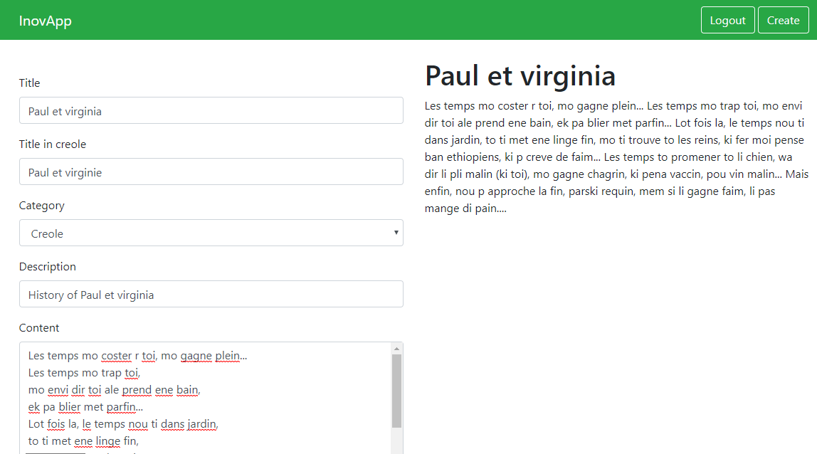
Creating content for the website.

Slide 5
How this will benefit Mauritius ?
A platform where users can learn about specific topics on the culture and heritage of Mauritius.

Slide 6
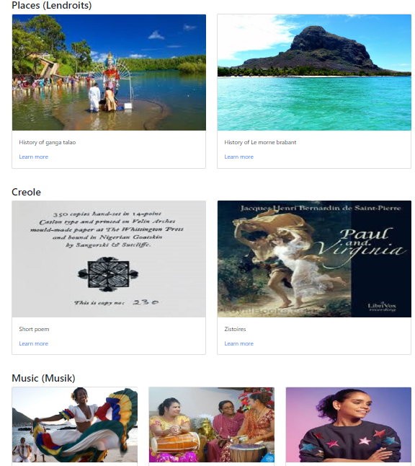
Displaying the content

Slide 7
Where it is applicable?
To be used by tourists as a platform of information related specifically to Mauritius.
To be used in primary schools as an educational learning resource.

Slide 8
Road Map
2019
March
2019 September
2020 March
6 months
6 months
Host Live
Post up vote
feature & admin review
Create an interactive Map to show heritage sites

